Slide 1
ECOLOGY (Part-1)
Dr. Prasenjit Adak

Slide 2
Introduction
Greek word “Oikos” meaning “home” and “logos” meaning “study”
Ecology: The study of organisms in their natural habitat interacting with their surroundings
Ecosystem: A self-regulating group of biotic communities of species interacting with one another and with their non-living environment exchanging energy and matter

Slide 3
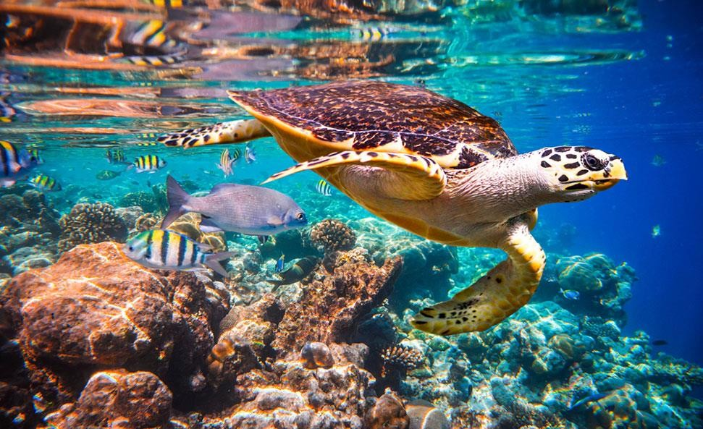
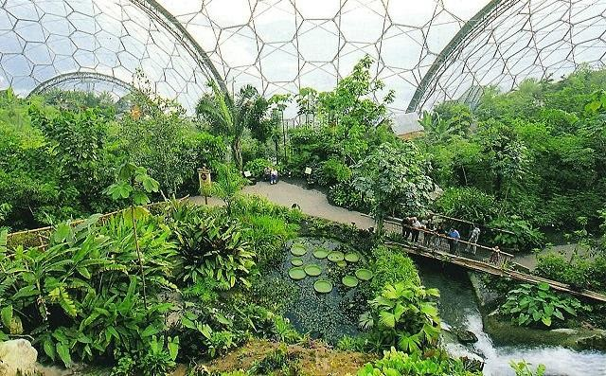
Classification of ecosystem
Natural ecosystem
Aquatic
Fresh water
Running water
Standing water
Marine
Terrestrial
Grassland
Forest
Desert
Artificial / Engineered ecosystem

Slide 4
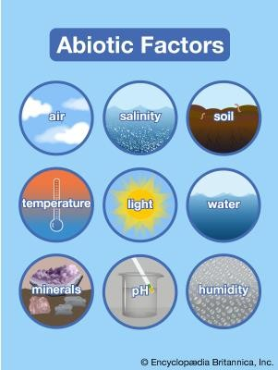
Structural unit
Abiotic
Physical
Climatic (Sunlight, temperature, humidity, rainfall, wind)
Edaphic (soil type, soil moisture, soil reaction)
Geographic (Latitude, longitude, Altitude)
Chemical
Major nutrients
Trace elements
Pollutants
Organic substances

Slide 5
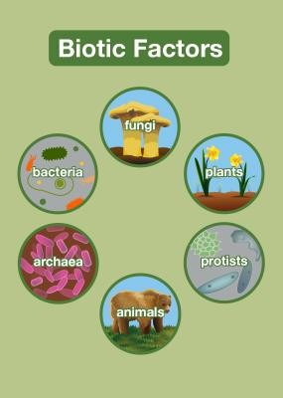
Structural unit
Biotic
Producers
Photo-autotrophs
Chemo-autotrophs (Nitrosomonas, Iron bacteria, Methanogens)
Consumers
Herbivores
Carnivores
Omnivores
Detritivores
Decomposers

Slide 6
Limiting Factors
Factors which restrict the further growth of population
Availability of food
Water
Shelter
Space

Slide 7
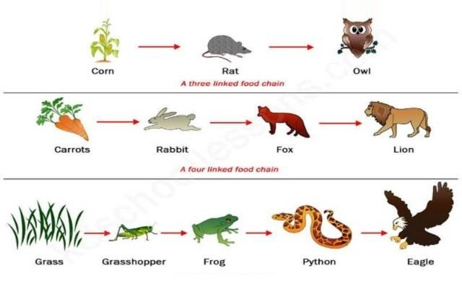

Food chain
Food chain is a series of groups of organisms called trophic levels, in which, there is repeated eating and eaten by so as to transfer food energy.
Tertiary Consumer
Secondary Consumer Primary Consumer Producer
Trophic Levels

Slide 8
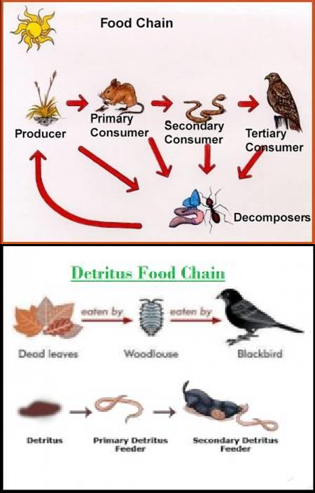
Types of Food Chain
Grazing food chain
Grass → Rabbit → Fox
Algae → Water flea → Small fish → Big fish
Detrius food chain
Dead organic matter → Fungi → Bacteria
Significance of food chain
Energy flow
Nutrient cycles
Ecological balance (population size regulation)
Biomagnification
The process by which a compound (such as a pollutant or pesticide) increases its concentration in the tissues of organisms as it travels up the food chain

Slide 9
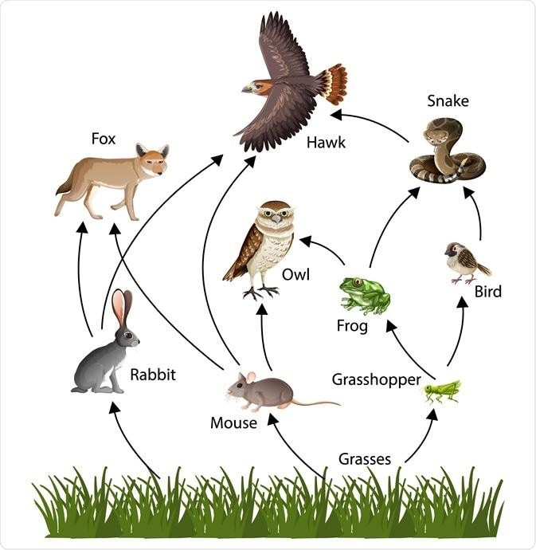
Food Web
Food web: A network of food chain
Food web is an important conceptual tool for illustrating the feeding relationships among species within a community, revealing species interactions and community structure, and understanding the dynamics of energy transfer in an ecosystem.

Slide 10
Ecological pyramids
An ecological pyramid is a graphical representation of different living organisms at different trophic levels. It was given by Raymond Lindman and G. Evelyn Hutchinson.
These pyramids are shaped like actual pyramids with base broads and narrow down at the apex.
The first trophic level is producers and the next topic level is primary consumer and so on.
Graphical representation of the ecological pyramid shows a relationship between living beings at different trophic levels.
Ecological Pyramids are of three types:
Pyramid of numbers
Pyramid of biomass
Pyramid of energy

Slide 11
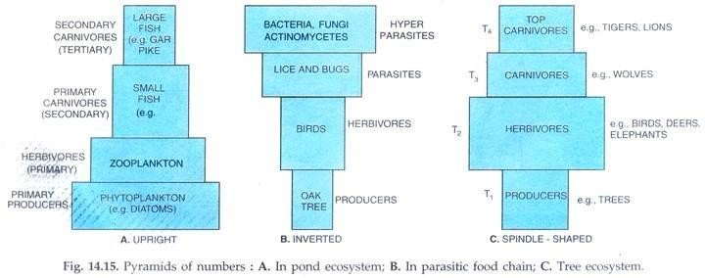
Ecological pyramids
Pyramid of number

Slide 12
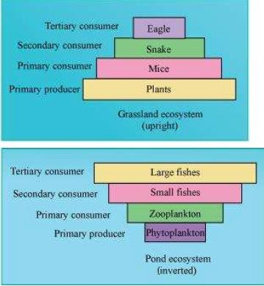
Ecological pyramids
Pyramid of biomass

Slide 13
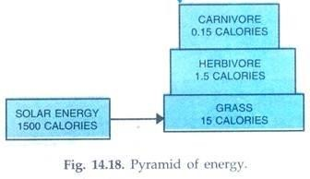
Ecological pyramids
Pyramid of energy

Slide 14
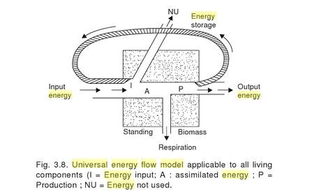
Energy flow
Universal energy flow model

Slide 15
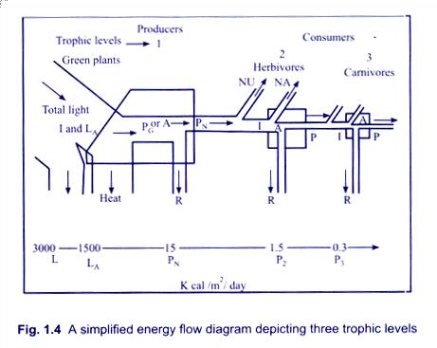
Energy flow
Single channel energy flow model

Slide 16
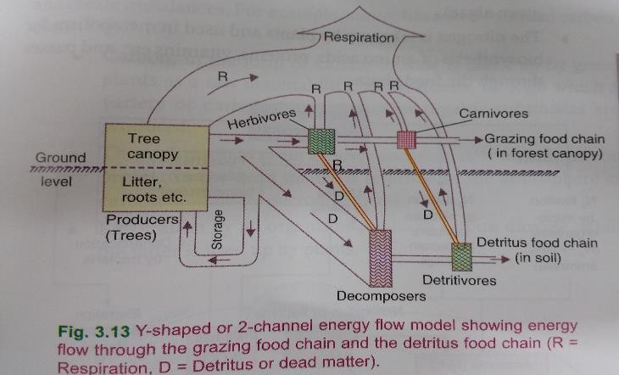
Energy flow
Double channel or Y-shaped energy flow model

Slide 17
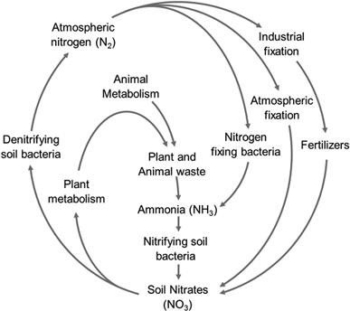
Nutrient cycles
Nitrogen

Slide 18
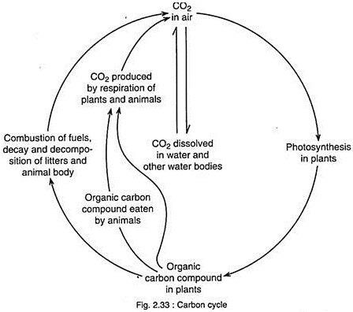
Nutrient cycles
Carbon

Slide 19
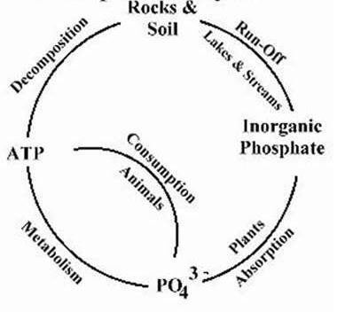
Nutrient cycles
Phosphorus

Slide 20
Production of biomass
Primary production
Biomass production using photosynthesis
Secondary production
Biomass production by consuming producers

Slide 21
To be continued…

